Slide 1

CPU SCHEDULING
MODULE CODE: CS 6146
MODULE NAME: Operating Systems
FACILITATOR: Pangahela, R. A
Email: pangriz@gmail.com Phone: +255 742 926 569

Slide 2
Lecture 3: CPU Scheduling
3.1 Basic Concepts
3.2 Scheduling Criteria
3.3 CPU Scheduling Algorithms
  First-Come First-Serve Scheduling, FCFS
  Shortest-Job-First Scheduling, SJF
  Priority Scheduling
  Round Robin Scheduling
  Multilevel Queue Scheduling
  Multilevel Feedback-Queue Scheduling
3.4 Multiple-Processor Scheduling

Slide 3
3.1 Basic Concepts
  CPU scheduling allows one process to use the CPU while the execution of other processes are on hold.
  Each process will pass into cycles of CPU execution and I/O wait, CPU burst followed by I/O burst and so on.
  CPU burst time is of main concern to the CPU scheduling.

Slide 4
  The important role of an OS is the act of managing and scheduling these activities to maximize the use of the resources and minimize wait and idle time.
  CPU scheduling decisions may take place when a process:
      Switches from running to waiting state
      Switches from running to ready state
      Switches from waiting to ready
      Terminates

Slide 5
3.2 Scheduling Criteria
  CPU utilization – keep the CPU as busy as possible
  Throughput – The number of processes that complete their execution per time unit
  Turnaround time – amount of time to execute a particular process
  Waiting time – amount of time a process has been waiting in the ready queue
  Response time – amount of time it takes from when a request was submitted until the first response is produced, not output (for time-sharing environment)

Slide 6
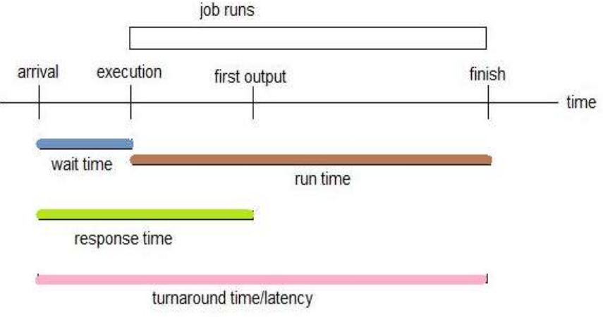
Scheduling Criteria – in Time Axis

Slide 7
Scheduling Algorithm Optimization Criteria
  Max CPU utilization
  Max throughput
  Min turnaround time
  Min waiting time
  Min response time

Slide 8
3.3 CPU Scheduling Algorithms
CPU scheduling deals with the problem of deciding which of the processes in the ready queue is to be allocated the CPU. Algorithms user are:
  First-Come First-Serve Scheduling, FCFS
  Shortest-Job-First Scheduling, SJF
  Priority Scheduling
  Round Robin Scheduling
  Multilevel Queue Scheduling
  Multilevel Feedback-Queue Scheduling

Slide 9
First- Come, First-Served (FCFS) Scheduling
FCFS is very simple - like customers waiting in line at the bank or the post office.
However, FCFS can return some very long average wait times, particularly if the first process to get there takes a long time. For example, consider the following Example

Slide 10
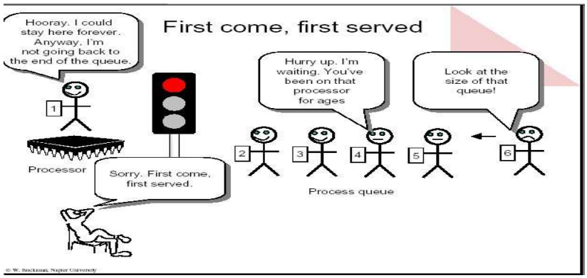

Slide 11

Example of FCFS
  Process Burst Time
  P₁ 24
  P₂ 3
  P₃ 3
Suppose that the processes arrive in the order: P1, P2, P3 The Gantt Chart for the schedule is:

Slide 12
  Waiting time for P1 = 0; P2 = 24; P3 = 27
  Average waiting time: (0 + 24 + 27)/3 = 17

Slide 13
Shortest-Job-First (SJF) Scheduling
The idea behind the SJF algorithm is to pick the fastest little job that needs to be done, get it out of the way first, and then pick the next smallest fastest job to do next.
Technically this algorithm picks a process based on the next shortest CPU burst, not the overall process time.
SJF is optimal – gives minimum average waiting time for a given set of processes
  The difficulty is knowing the length of the next CPU request

Slide 14
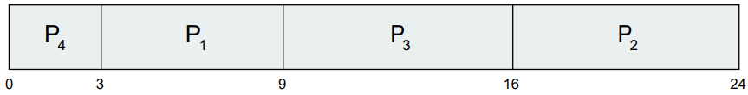
Example of SJF
  Process Burst Time
  P1 6
  P2 8
  P3 7
  P4 3
SJF scheduling chart
Average waiting time = (0 + 3 + 9 + 16) / 4 = 7

Slide 15
Priority Scheduling
A priority number (integer) is associated with each process
The CPU is allocated to the process with the highest priority (smallest integer = highest priority)
Priorities can be assigned either internally or externally.
Internal priorities are assigned by the OS using criteria such as average burst time, ratio of CPU to I/O activity, system resource use, and other factors available to the kernel.

Slide 16
External priorities are assigned by users, based on the importance of the job.
Priority scheduling can suffer from a major problem known as indefinite blocking, or starvation, in which a low-priority task can wait forever because there are always some other jobs around that have higher priority.
Solution = Aging – as time progresses increase the priority of the process

Slide 17
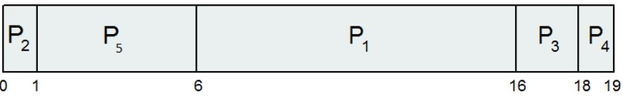
Example of Priority Scheduling
  Process Burst Time Priority
  P₁ 10 3
  P₂ 1 1
  P₃ 2 4
  P₄ 1 5
  P₅ 5 2
Priority scheduling Gantt Chart
Average waiting time = (0 + 1 + 6+ 16+ 18) /5 = 8.2 m sec

Slide 18
Round Robin (RR)
Round robin scheduling is similar to FCFS scheduling, except that CPU bursts are assigned with limits called time quantum.
When a process is given the CPU, a timer is set for a time quantum.
  If the process finishes its burst before the time quantum timer expires, then it is swapped out of the CPU just like the normal FCFS algorithm.
  If the timer goes off first, then the process is swapped out of the CPU and moved to the back end of the ready queue.

Slide 19
Round Robin (RR) cont…
The ready queue is maintained as a circular queue, so when all processes have had a turn, then the scheduler gives the first process another turn, and so on.
RR scheduling can give the effect of all processes sharing the CPU equally.

Slide 20
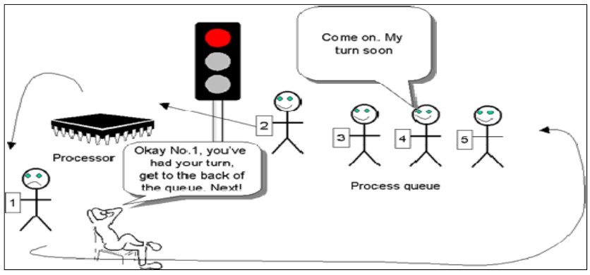

Slide 21
Advantages and Drawbacks of Round Robin (RR)
The advantages of the round robin scheduling algorithm are:
  The algorithm is fair because each process gets a fair chance to run on the CPU.
  Better response than SJF
The drawbacks of the round robin scheduling algorithm are as follows;
  there is an increase number of context switching that occurs with considerable over heads.
  Typically, higher average turnaround than SJF.

Slide 22
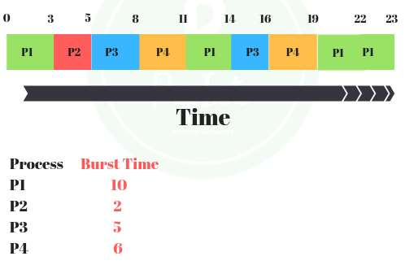
Example of RR with Time Quantum = 3

Slide 23
RR Time Quantum Value
A short quantum:
  Good: because processes need not wait long before they are scheduled in.
  Bad: because context switch overhead increase
A long quantum:
  Bad: because processes no longer appear to execute concurrently and that may degrade the system performance (same like FCFS)

Slide 24
Time Quantum q should be large compared to context switch time but not larger than average process time
q should be usually 10ms to 100ms, when context switch < 10 micro s

Slide 25
END
THANK YOU

